Slide 1
Annapolis Royal
CEC 2025

Slide 2
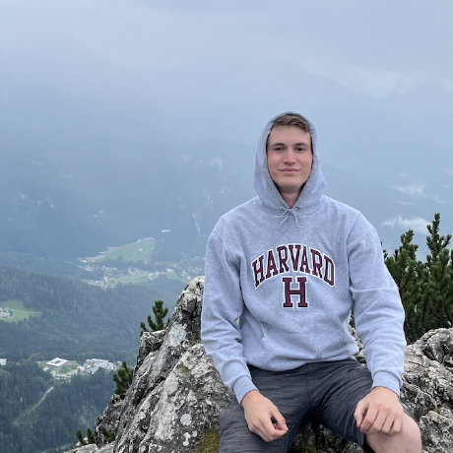
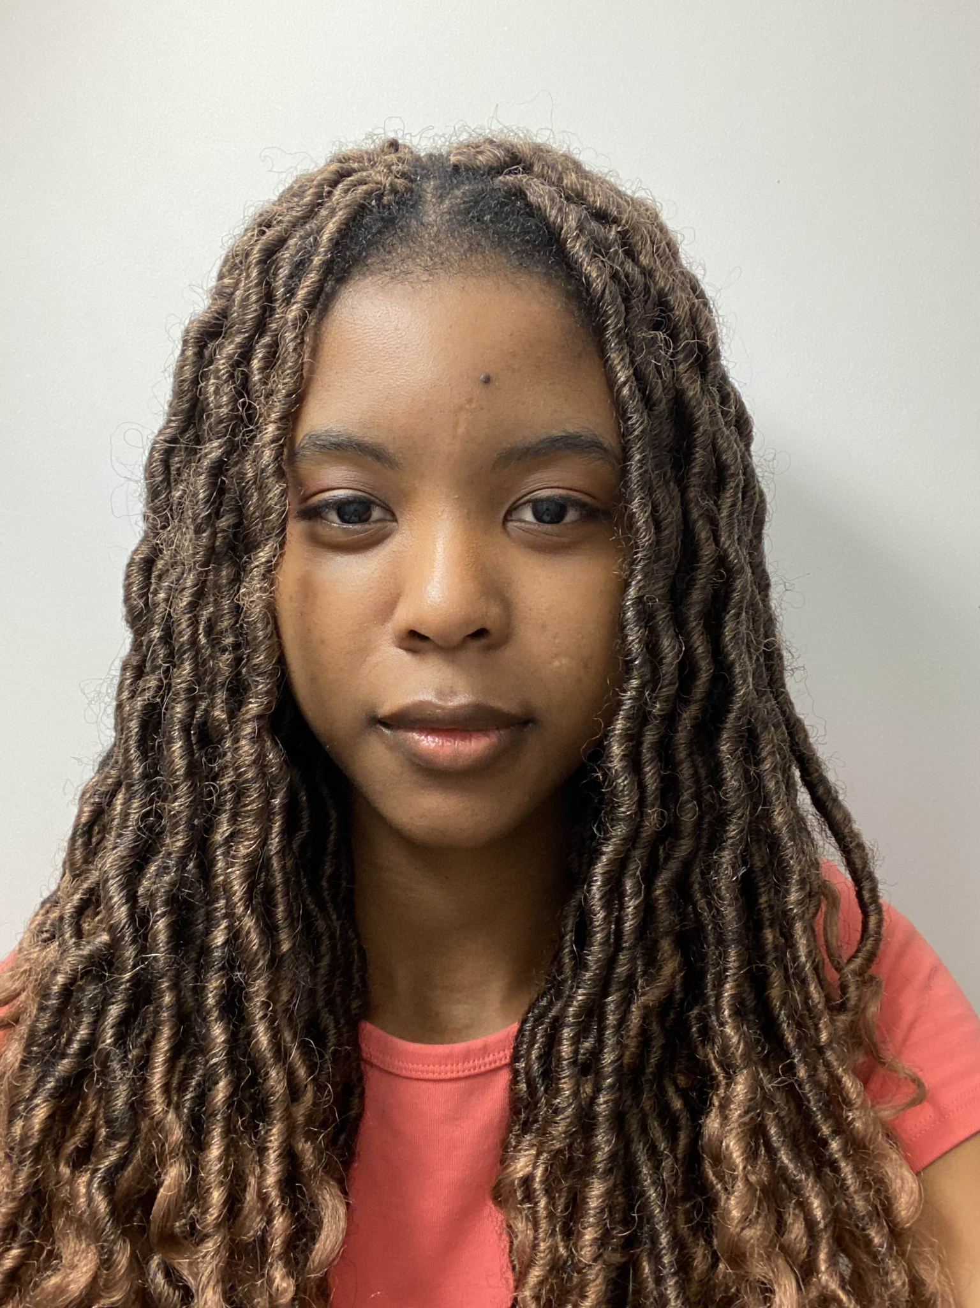
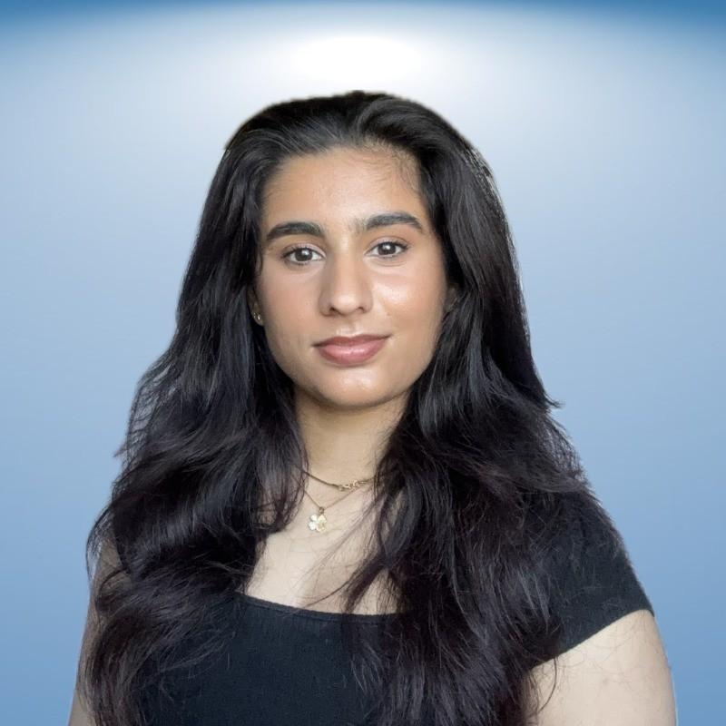

The Team
Maksim Sharoika
Shema Dabiri
Simran Brar
Muhammad Zaman

Slide 3
Roadmap
Our Solution
Results
The Problem
Code Review
Conclusion

Slide 4
01.
Introduction

Slide 5
The MRI Scan Problem
Theme: The Ethical Engineer - How does using A.I. (ML) to scan MRI’s impact patients?
Problem: The JBOW hospital is experiencing high volumes of patients more than they can keep up with. JBOW Hospital is in need of a program which can interpret MRI scans of the brain, to aid diagnosis and treatment for people undergoing brain injury.
Task: Given an MRI scan in PNG format develop a way to process the image and predict whether or not a given scan contains the marking of a brain tumor with a high level of accuracy and dependency.
Input: A couple thousand training images split up into images with a tumor and images without a tumor.
Output: A csv of image names and whether or not the coordinating image contained a tumor.

Slide 6
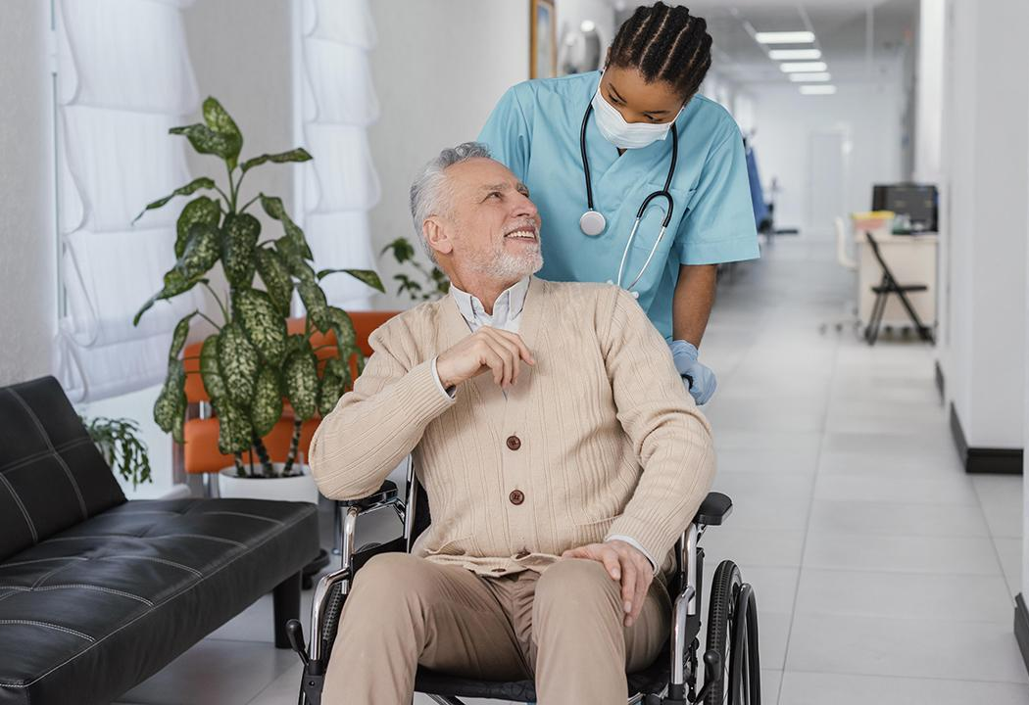
Context
On average, 50% of people get an MRI within 64 days. This is still over 2 months. And can lead to tragedies like in the case of Destiny Rennie.
https://waittimes.novascotia.ca/procedure/mri-nova-scotia-health-authority

Slide 7
Why it matters?
There is a lot of strain on the healthcare system not only in Nova Scotia but all across Canada. So we need to leverage technology where we can’t fill the personnel gaps. Technology can help speed up and simplify medical processes while still maintaining reliability and security of user information.
The average age of a Canadian is increasing; thus more strain on the medical system will come in the coming decades.
https://www.statista.com/statistics/444844/canada-median-age-of-resident-population/

Slide 8
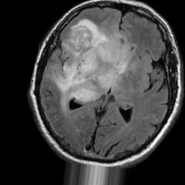
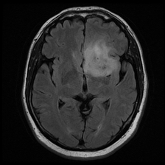
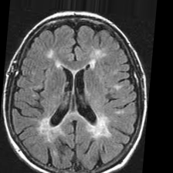
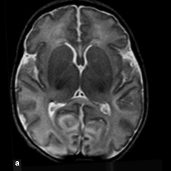
Data Overview
Input Data: Was scrubbed MRI’s meaning no personal data or identifying markers were present to identify the individuals. Relatively hard tasks as tumors don't have a defined shape. We also utilized data transformation for model training.
Output Data: A CSV file with image file name and a yes/no based solution prediction, an output based on a image inputted by a user.

Slide 9
02.
Methodology/Considerations

Slide 10
Design Considerations
Simple to use
Practical
Efficient
Program is intended to be used by doctors and medical technicians so there should be a relatively small learning curve and a simple intuitive UI
A widely available tech stack and implementation would allow for better future modifications and easy debugging.
An efficient solution was chosen as time is our biggest constraint; speeds up training.

Slide 11
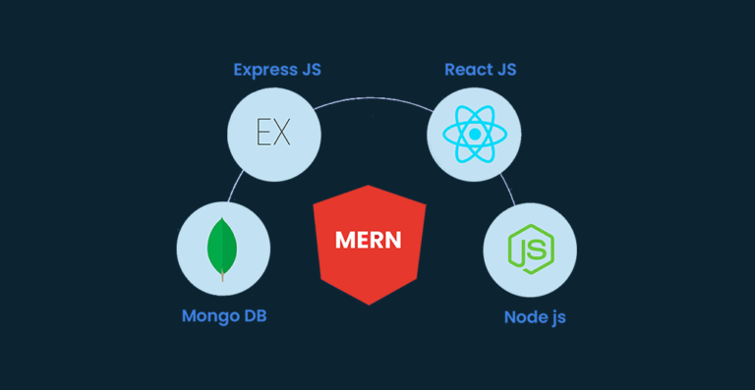


Tech Stack
https://www.jaroeducation.com/blog/what-is-mern-development-how-to-use-mern-stack/
https://en.wikipedia.org/wiki/Python_%28programming_language%29
https://rock-the-prototype.com/en/software-development/github/

Slide 12
03.
Our Algorithm

Slide 13
Our Model
We used EfficientNetV2 with ImageNet1K. (convolutional neural network)
As a Criterion we used Cross Entropy. (classification)
As an Optimizer we used Adam.
As a Scaler we used Grad Scaler.
We decided to start with 5 Epochs.

Slide 14
Why these models?
EfficientNetV2 offers a strong balance of accuracy and efficiency, outperforming models like ResNet and Inception. It works well across tasks such as classification, segmentation, and detection, since it is optimized for these tasks.
We chose it over ResNet and VGG due to its superior efficiency and scalability. With just 5 epochs and data augmentation, it converges faster, and using ImageNet1K pre-trained weights speeds up training further.
Adam optimizer and GradScaler enhance convergence and efficiency by adjusting the learning rate and reducing memory usage, making training faster and more efficient compared to ResNet and VGG, which require more data and epochs.
Due to the time constraint ability to train and verify our models was front and centre.
https://medium.com/data-science/efficientnetv2-faster-smaller-and-higher-accuracy-than-vision-transformers-98e23587bf04

Slide 15
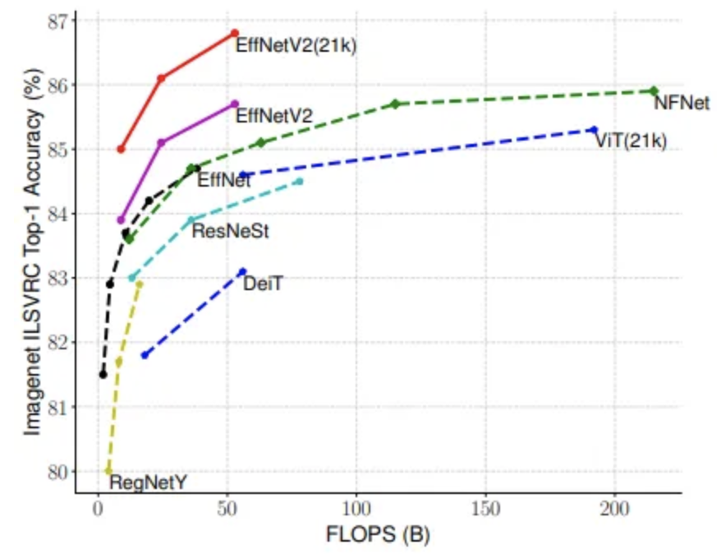
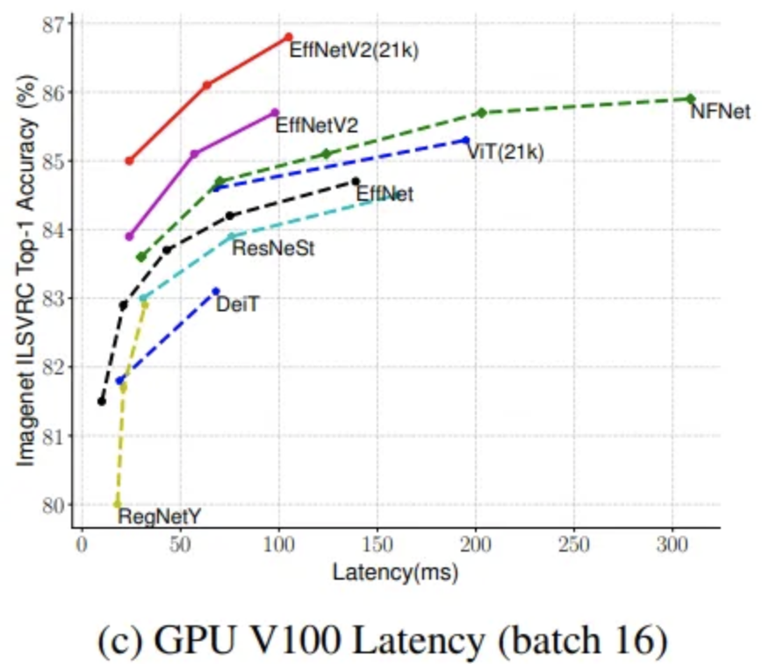
Why these models?
https://medium.com/data-science/efficientnetv2-faster-smaller-and-higher-accuracy-than-vision-transformers-98e23587bf04

Slide 16
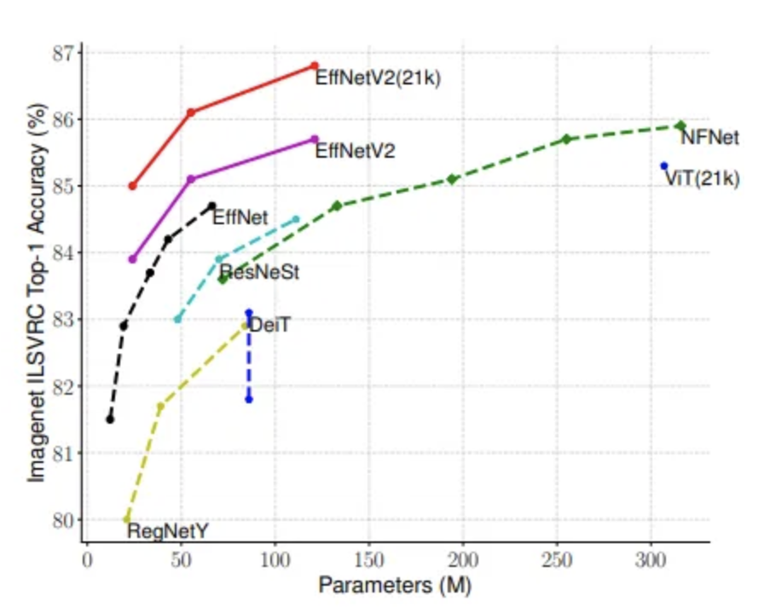
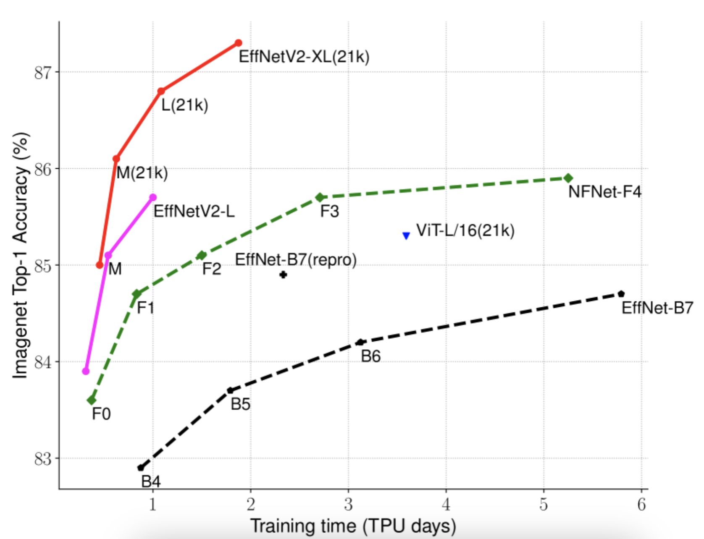
Why these models?
https://medium.com/data-science/efficientnetv2-faster-smaller-and-higher-accuracy-than-vision-transformers-98e23587bf04

Slide 17
How the model works?
How the model operates: The Convolutional Neural Network (CNN) layers in the model are designed to automatically detect various patterns, edges, and shapes within the input images. As the image data passes through these layers, the model learns determines based on its training, whether or not a tumor is present, returning either a true or false result based on the learned patterns.
How the model was trained: The model was trained using a wide range of data transformations, such as rotating, flipping, and adjusting the hue and saturation of the images. The transformed images were then converted into tensors, which are the data format required by the model. During training, the model’s parameters were fine-tuned through multiple iterations.

Slide 18
04.
Solution

Slide 19
Features/Solution
01.
02.
03.
CSV output
User Interface
Pre-trained Model
Our solution outputs the result, confidence level and likelihood of correct result for transparent results.
We utilized a simple UI for medical practitioners to interface with the model. We also display all relevant info for accurate interpretation.
The pretrained model gives this solution a high level of reliability and accuracy.

Slide 20

05.
Demo and Code Review

Slide 21
06.
Dataset/Results

Slide 22
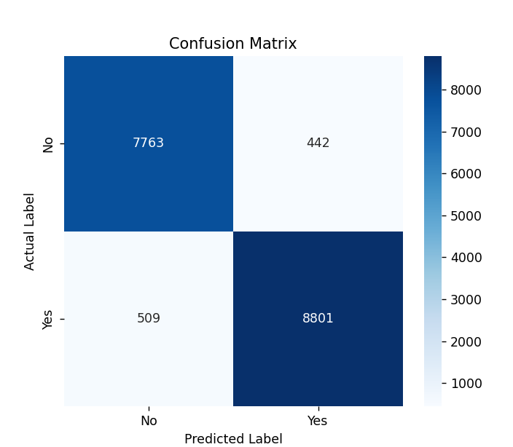
Confusion Matrix
From this we can calculate a 94.7% data accuracy

Slide 23
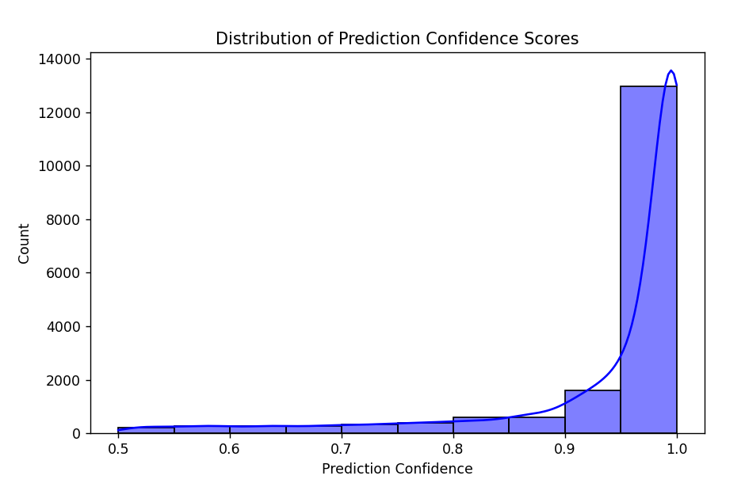
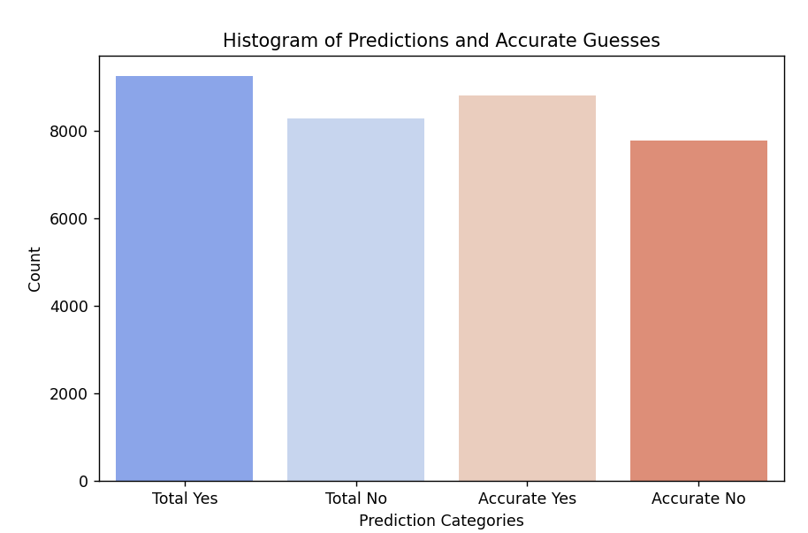

Slide 24
Dataset Results
KEY:
First Letter: S (Small, more efficient model), M (Medium, bigger, less efficient model, supposedly more accurate)
Second Letter: S (Simple transforms), A (Advanced transforms like changing hue and saturation)
v2_s - simple transforms - SS
Trained off 100 random images:
Testing with 100 random images: 92.00%
Testing with 1000 random images: 87.10%
Testing with 5000 random images: 88.68%
v2_s - simple transforms - SS
Trained off 250 random images:
Testing with 100 random images: 93.00%
Testing with 1000 random images: 92.50%
Testing with 5000 random images: 92.28%
v2_s - simple transforms - SS
Trained off 500 random image:
Testing with 100 random images: 93.00%
Testing with 1000 random images: 95.00%
Testing with 5000 random images: 94.42%
Testing with 10000 random images: 94.53%
2nd: 94.62%
v2_s - simple transforms - SS
Trained off at 750 random images:
Testing with 100 random images: 93.00%
Testing with 1000 random images: 93.30%
Testing with 5000 random images: 92.92%
v2_s - simple transforms - SS
Trained off 1000 random images:
Testing with 100 random images: 98.00%
Testing with 1000 random images: 94.40%
Testing with 5000 random images: 93.72%
Testing with 10000 random images: 93.93%
2nd: 93.55%
v2_m - simple transforms - MS
Trained off 100 random image (Advanced):
Testing with 100 random images: 81.00%
Testing with 1000 random images: 83.80%
Testing with 5000 random images: 82.40%
v2_m - advanced transforms - MA
Trained off 100 random image (Advanced):
Testing with 100 random images: 85.00%
Testing with 1000 random images: 88.10%
Testing with 5000 random images: 87.20%
v2_m - advanced transforms - MA
Trained off 500 random image (Advanced):
Testing with 100 random images: 82.00%
Testing with 1000 random images: 89.90%
Testing with 5000 random images: 87.40%

Slide 25
07.
Troubleshooting

Slide 26
Issues Faced
Selecting the Model
Accuracy Issues
Initially we didn’t know which model to use, but we ended up with EfficientNetV2, after each group member ran test models.
At the start of testing, we had a roughly 70-80% accuracy which was not ideal. But as we continued to train, we ended up at ~94%.

Slide 27
08.
Future Implementations

Slide 28
Technical Implementations
Higher Accuracy
Given the time constraint we were limited to what we had, but given more time, we would be able to increase the accuracy more.
Custom Model Implementation
Given more time, we believe a more custom solution may be more beneficial as opposed to a pre configured model due to nature of images. Use of a more efficient language like C#.
Allowing for more file types
Actual MRI file types such as DICOM (.dcm) and NIfTI (.nii, .nii.gz).

Slide 29
Ethical Considerations
Sensitive Data
Data Bias
Patient Consent
AI can only predict as good as the data set that it was trained on. We need to make sure that the data set includes people from all walks of life. For example if this data set is mostly adults what would be the repercussions if used on a child's scan?
MRI scans and the medical info they contain about a person is highly personal and therefore protected information. The AI model must run in a contained environment (local) and prevent the release of information into bad actors hands.
Even if the Program is 100% secure the patient should still have the right to accept AI use or not as they have rights over how their medical info is used and processed especially when it comes to new technology.

Slide 30
09.
Conclusion

Slide 31
Conclusion
Accuracy
Simplicity
Efficiency
UI
Our Model is 94.77% accurate offering reliable results.
The Program is built on pretrained models customized to our use and is a lightweight solution.
Our test set can process 1000 images in under 2 minutes on a regular machine.
The simple and easy to use UI makes this an appealing application.

Slide 32
THANKS!
Do you have any questions?

Slide 33
References
ChatGPT: for library referencing of calls/functions/features, errors/helping debug issues, algorithm development.
https://github.com/Sha3-git/CEC25
https://medium.com/data-science/efficientnetv2-faster-smaller-and-higher-accuracy-than-vision-transformers-98e23587bf04
https://paperswithcode.com/method/efficientnetv2#:~:text=EfficientNetV2%20is%20a%20type%20convolutional,to%20jointly%20optimize%20training%20speed.
https://arxiv.org/pdf/2104.00298#:~:text=Our%20ex%2D%20periments%20show%20that,causes%20a%20drop%20in%20accuracy.

